Slide 1
Managing and Installing Software
Team or presenters name
Date: 26/05/2020
Location: DUB

Slide 2




Virtual Housekeeping
Use
Headsets
Go on
Mute
Participate Actively
Minimize Distractions
Notes:
***Please ensure you have your headset plugged in so we can avoid echoing and maintain audio quality
***Throughout the session, please keep your mic on mute to avoid background noise during the presentation portions.
***Please be aware you will be asked to participate and engage throughout the session. We ask that you are fully active in the chat box, and are also ready to be called on and unmute if needed. We’ll also have you click on some links to view videos, participate in polls and at some point during the session, we’ll be sending you to specific break out rooms depending on which service you’ll be shadowing.
***Lastly, we ask that you’re fully present. Keeping engaged is even more difficult in a virtual setting, so make sure you turn off notifications, maybe set an out of office in your email. Minimize distractions

Slide 3
Course objectives
Familiarizing different package managers
Be able to install/update/remove software
Troubleshooting

Slide 4
Package managers
Package managers provide tool for individual software packages
There are three major Linux package managers:
YUM using RPM (RHEL/AL/CentOS/Fedora)
APT using DPKG (Debian/Ubuntu)
Zypper using RPM (Suse)
Package Managers maintain:
Packages
Installed File Database
Dependencies
Checksums
Upgrades and Uninstall
Binary Package Creations
Notes:
Yellowdog Updater, Modified was developed originally for Yellow Dog Linux (discontinued)
RPM (Red Hat Package Manager)
APT (Advanced Package Tool)
DPKG (Debian Package)
Zypper ZYpp (or libzypp; "Zen / YaST Packages Patches Patterns Products"[

Slide 5



YUM and RPM (intro)
Yum recommended to manage software
Yum uses an internal database to keep track of packages
Uses repositories to obtain package information and downloads
rpm command is used on specific software packages
Amazon linux
Notes:
yum is the primary tool for getting, installing, deleting, querying, and managing Red Hat Enterprise Linux RPM software packages from official Red Hat software repositories, as well as other third-party repositories.
yum is used in Red Hat Enterprise Linux versions 5 and later. Versions of Red Hat Enterprise Linux 4 and earlier used up2date.
(no amazon linux logo available)

Slide 6

YUM commands
yum info httpd
yum provides httpd
yum –y install httpd-2.4.39-1.amzn2.0.1.x86_64
yum -y remove httpd
yum list installed | less
yum check-update
yum update
yum repolist all
yum provides /etc/httpd/conf/httpd.conf
yum history
Notes:
Show the commands live
https://access.redhat.com/articles/yum-cheat-sheet

Slide 7
rpm commands
What do we need rpm for at all then?
rpm --verify httpd
missing c /etc/httpd/conf/httpd.conf
rpm -a --setperms
Notes:
Most functions can be used via yum, but not all of them
verify files used by software package
reset permissions

Slide 8

yum and rpm (configuration and repositories)
/etc/yum.conf
/etc/yum.repos.d/…
Yum repolist all
yum-config-manager --add-repo repo_url
DNF used since Fedora 22 and Red Hat 8
Notes:
Talk about yum config and repos
Explain some differences with DNF(dandified yum), mainly for awareness
https://dnf.readthedocs.io/en/latest/cli_vs_yum.html

Slide 9


Apt and dpkg (intro)
Used for all Debian based system (Ubuntu)
Apt is the package manager
Dpkg install single packages
Apt uses an internal database to keep track of packages
Apt uses repositories to obtain package information and downloads
Notes:
Apt is the equivalent to rpm
Dpkg is the equivalent to rpm
Apt = advanced packaging tool
Dpkg = Debian package

Slide 10
Apt command basics
apt update (updates repository database)
apt upgrade (updates all software packages)
apt update && apt upgrade –y (does both)
apt search apache2
apt policy apache2
apt list –upgradable
apt install apache2
Notes:
Do a live demo here as well
Commands are similar to yum, man apt will show more help
Mention: apt-get and apt-cache are lower level backends commands
Aptitude is a front end to apt which is a front end to apt-get which is a manager for dpkg

Slide 11
Dpkg command basics
dpkg -l apache2 (list details)
dpkg -L apache2 (lists files for package)
wget http://ftp.us.debian.org/net-tools[...]amd64.deb
Dpkg –i <PackageName.deb>
dpkg -c <PackageName.deb> (view contents)
Notes:
Live demo recommended

Slide 12
apt and dpkg (configuration and repositories)
/etc/apt/apt.conf or subdirectories
/etc/apt/sources.list
add-apt-repository
apt-cache policy
Notes:
Go through different ways to configure and list/add repos

Slide 13

zypper (intro and basic commands)
zypper se apache2
zypper in apache2
zypper in php5*
zypper in apache2*.rpm
zypper up
zypper up apache2
zypper rm apache2
Notes:
With zipper people like to use short version (like se for search, lr for list repository)
Se search
In install
Up update
Rm remove

Slide 14
zypper (configuration)
zypper lr –uP
zypper ref
zypper mr -d 6
zypper ar http://download.opensuse.org/update/11.1/ update
/var/log/zypp/history
/etc/zypp/zipper.conf
Notes:
lr – list repos with repo URL and priority
ref – refresh repos
mr – modify repo, delete option number 6
ar – add repo
log and config file
https://en.opensuse.org/images/1/17/Zypper-cheat-sheet-1.pdf

Slide 15

Compiling and Installing from source
Three step process (configure, make, make install)
Read the manual or the README/INSTALL file
$ wget https://mirrors[...]is.com/apache//httpd/httpd-2.4.43.tar.gz
$ gzip -d httpd-NN.tar.gz
$ tar xvf httpd-NN.tar
$ cd httpd-NN
$ ./configure --prefix=PREFIX
$ make
$ make install
$ vi PREFIX/conf/httpd.conf
$ PREFIX/bin/apachectl -k start
Notes:
Old school way, which is not recommended but might be needed in edge cases
Also needed if no package is available from repo
Does not check any dependencies, so expect quite a few error during compiling
http://httpd.apache.org/docs/trunk/install.html

Slide 16

Troubleshooting
Verify if it’s a general network issue
Keep EC2 specifics in mind (product code, BYOL)
Are you able to replicate it with the base AMI?
Clear cache, update repositories, list repositories
Is the system registered (Red Hat/Suse)
Keep possible proxy in mind
Notes:
1) telnet/netcat/curl etc. to check for network issues (SG/NACL/firewall/proxy)
2) Mention EC2 product codes for Red Hat and Suse as possible issue
yum clean packages
To purge the old package information completely, execute the following command:
yum clean headers
To clean any cached xml metadata from any enabled repository, execute the following
yum clean metadata
If you wish to clean all the cached files from any enabled repository at once, execute the
Following command:
yum clean all
list repos to check that the right repos are used for the system, check for typos
Proxy might be configured via config file or system wide variable
export https_proxy= http://{Proxy-User-Name}:{Proxy-Password}@<Proxy-Server-IP-Address>:<Proxy-Port>

Slide 17
Troubleshooting
Systemctl status <service>
Check the system log file or the app log file
Verbose option in scripts for SysVinit (set –x)
Check changes in config files
Notes:
Common troubleshooting steps

Slide 18
You should now be familiar with…
Recognize different package managers
Be able to install/update/remove software
Troubleshooting

Slide 19
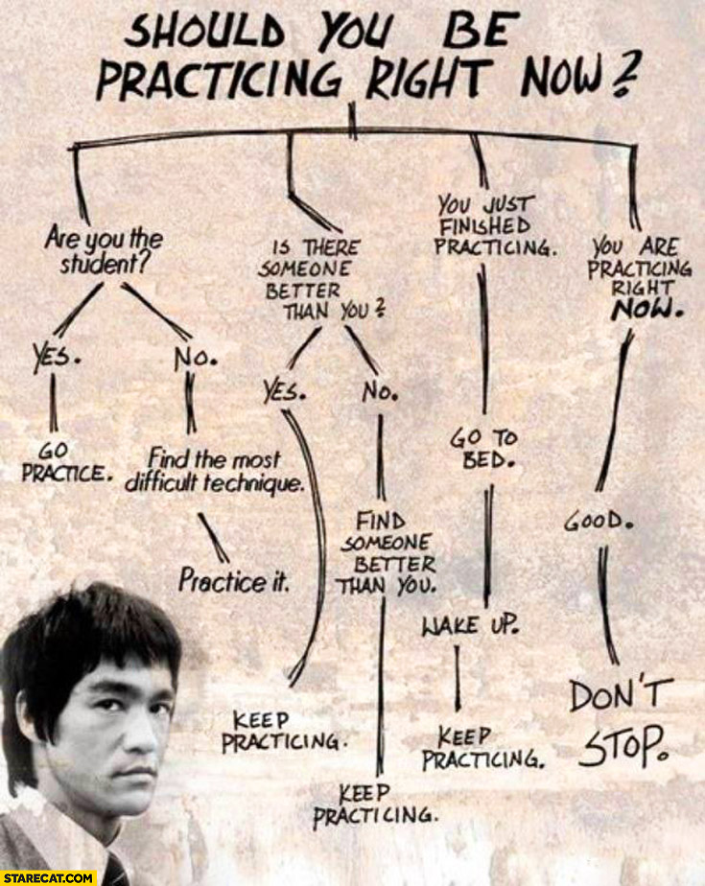
Practical Exercise 1
Use a generic AL2/AL1 instance
List the repositories configured
List updates available
Add EPEL repo
Check if httpd2/apache is installed
Install the latest version
Install mysql
Install php
Notes:
https://aws.amazon.com/premiumsupport/knowledge-center/ec2-enable-epel/

Slide 20
Insist on the highest standards
Please take 2 minutes to complete the survey to let us know what you liked about the training and what can be improved.
This will help us to continue creating helpful and relevant training content.
Link is in the invitation email.

